Slide 1

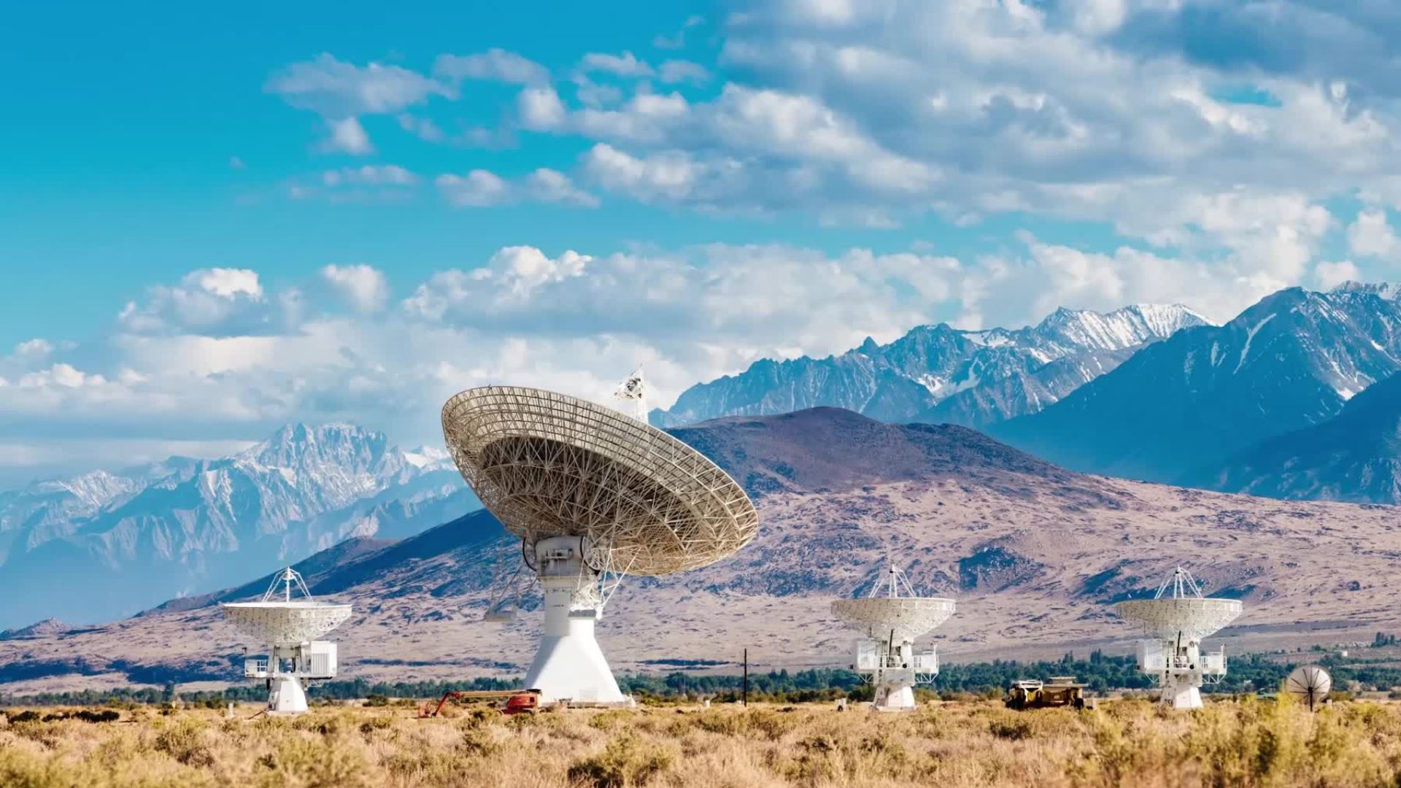
Weather Data Visualiser
By: QuantumFlux:
Abdul Rehman, Muhammad Ali, Advay Dingari, Muhammad Hamza, Azzam Ahmed, Staali

Slide 2
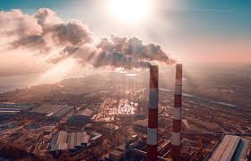
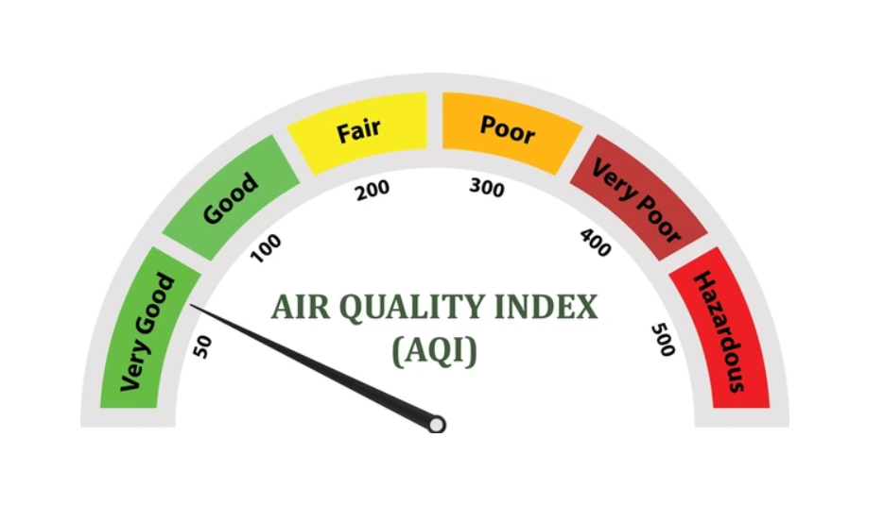
What is the challenge?
What is an Air Quality Data Visualiser?
To develop a web-based app that forecasts air quality by integrating real-time data with ground-based air quality measurements and weather data, notifying users of poor air quality, and helping to improve public health decisions.
An Air Quality Data Visualiser is a tool that takes air quality data and transforms it into clear, easy-to-understand visual formats like our map . The goal is to make complex yet easy to understand data about pollutants, emissions, and environmental factors more accessible and actionable.

Slide 3
What is an Air Quality Data Visualiser?
API: Serves as a set of rules that allow different software applications to communicate and interact with each other. An API acts as a messenger, enabling one program to request services or data from another program
Searchbar: This allows the user to search for the city they want to know the air quality about.
Map: Zooms in to the location of the city and shows all the details.
An Air Quality Data Visualiser is a tool that takes air quality data and transforms it into clear, easy-to-understand visual formats like our map . The goal is to make complex yet easy to understand data about pollutants, emissions, and environmental factors more accessible and actionable.

Slide 4


Elements of our website
Where does the data come from?
API: Serves as a set of rules that allow different software applications to communicate and interact with each other. An API acts as a messenger, enabling one program to request services or data from another program
Searchbar: This allows the user to search for the city they want to know the air quality about.
Map: Zooms in to the location of the city and shows all the details.
Our data comes from reliable sources like satellites, weather stations, and public APIs. It includes air quality, temperature, humidity, wind speed, and rainfall. We use both real-time and past data to keep our visualisations accurate and up to date. These trusted sources help make our platform useful for everyone — from everyday users to researchers.

Slide 5
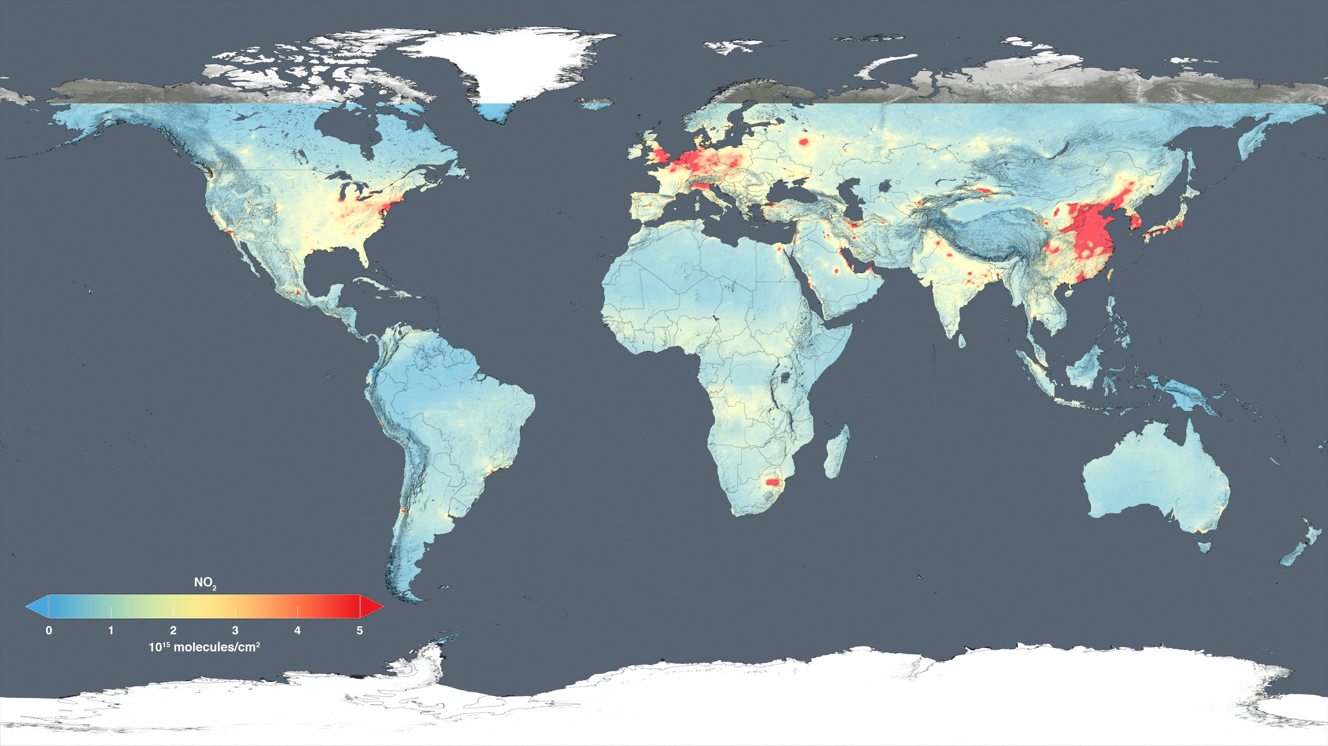
Where does the data come from?
Our data comes from reliable sources like satellites, weather stations, and public APIs. It includes air quality, temperature, humidity, wind speed, and rainfall. We use both real-time and past data to keep our visualisations accurate and up to date. These trusted sources help make our platform useful for everyone — from everyday users to researchers.
The common visualizations on our website include heatmaps for rainfall and humidity, as well as an interactive air quality map, which is one of our most important features. These visuals help users easily understand environmental conditions across different areas. We use open-source data from trusted sources, allowing us to provide accurate and real-time information. Our visualisations are designed to be clear, user-friendly, and regularly updated, making them useful for the public, students, and professionals alike.

Slide 6

Tools and Technologies used...
The common visualizations on our website include heatmaps for rainfall and humidity, as well as an interactive air quality map, which is one of our most important features. These visuals help users easily understand environmental conditions across different areas. We use open-source data from trusted sources, allowing us to provide accurate and real-time information. Our visualisations are designed to be clear, user-friendly, and regularly updated, making them useful for the public, students, and professionals alike.

Slide 7

Conclusion
In conclusion, our weather and air quality visualisations make complex data easy to understand and use. By combining open-source data with interactive tools, we help users track real-time environmental changes and make informed decisions. Our goal is to make this information accessible, clear, and useful for everyone.

